Slide 1
NBA Player Awards and Team Performance Prediction
EECS E6893 - Big Data Analytics
Group 19
Yuan Dou
Zhan Shu
Yingqi Ma

Slide 2
Goal and Value
The NBA, as the most prestigious basketball league, has the best basketball players in the world. Every fans has favourite player and team. So predictions about the game is the most popular topic among fans every year.
Predict awards voting results (Rookie of the Year, Sixth Man of the Year, Most Valuable Player, etc) and teams that can enter playoffs of current year, based on their previous performance.
Design a web application to help fans get the prediction of the player and team they picked.
Business values of the app have two aspects. One is for NBA team managers to get more accurate statistical data when doing trades. The other is for fans to visualize the performance of their favorite teams and players.

Slide 3
Data
We download the data from www.kaggle.com/datasets/sumitrodatta/nba-aba-baa-stats. The data was scraped from basketball-reference.com, one of the greatest comprehensive basketball stats site. We also use NBA_API to get the latest data and make the most accurate predictions.
Volume: it contains 21 csv files with around 30 MB datas of all the NBA Stats from 1947 till now
Velocity: the data is updated daily with the use of DAGs and the API to the get the latest information
Variety: on the team side, there are 8 csv files: totals, per game, per 100 possessions statistics, etc. on the player side, there are 13 csv files: per game, per 36 minute, shooting stats, etc.

Slide 4
Methods
Exploratory Data Analysis
Explore features that are most important to building the model and drop irrelevant features.
Data Preprocessing
Data Cleaning, feature selection based on different tasks
Classification
Using Scikit-learn library, train different ML models (Logistic Regression, Naive Bayes, Random Forest, MLP, KNN, SVC) and make comparisons.
Based on the tasks, select the model with highest performance and train the model.
DAG
Use nba_api to fetch latest data, trigger at 7a.m. everyday.
Make predictions using the corresponding model and the latest data.
Web application
Visualize statistics and prediction results using D3.

Slide 5



System
Updating data
Awards voting data Features
Get features
Train Models
SQL and sklearn
Raw data
Preprocessing
Training data
Performance stats
Players/Teams performance
Preprocessing
Save predicted data to cloud BigQuery
NBA API
Latest data
Prediction
Big Query
Predict awards outcome
Data visualization
Web application
Export data to app

Slide 6
Experiments
Performance of Classification Models
 | Logistic Regression | Gaussian Naive Bayes | RandomForest | MLP | KNN | SVC
Playoffs | 0.92219 | 0.91576 | 0.91848 | 0.88043 | 0.87228 | 0.89130
MVP | 0.93333 | 0.88888 | 0.93016 | 0.92063 | 0.92381 | 0.93333
DPOY | 0.91477 | 0.85227 | 0.90909 | 0.91477 | 0.90909 | 0.91477
ROY | 0.87368 | 0.84211 | 0.83158 | 0.86316 | 0.78947 | 0.81053
SMOY | 0.92258 | 0.86452 | 0.94839 | 0.93548 | 0.94194 | 0.93548

Slide 7
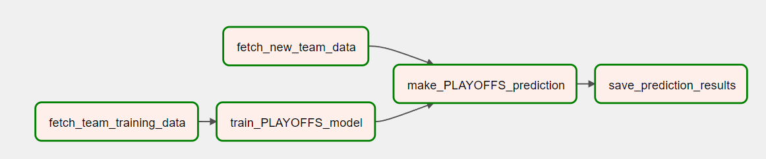
DAG for Team Performance Prediction
Use data from 1980-2022 as training data
Train logistic regression model for PLAYOFFS
Fetch latest data using nba_api
Make prediction with the pre-trained model and latest data (predict_proba)
Save prediction results to BigQuery

Slide 8
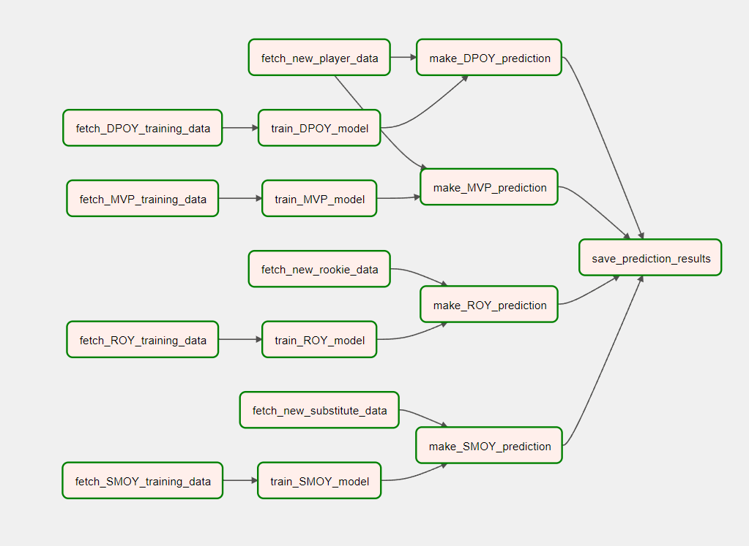
DAG for Player Awards Prediction
A total of four tasks(MVP, DPOY, ROY, SMOY)
Rookie data: player with 1 year of experience
Substitute data: player have played less than half of the games as starters
Combine the four prediction results and save to BigQuery

Slide 9
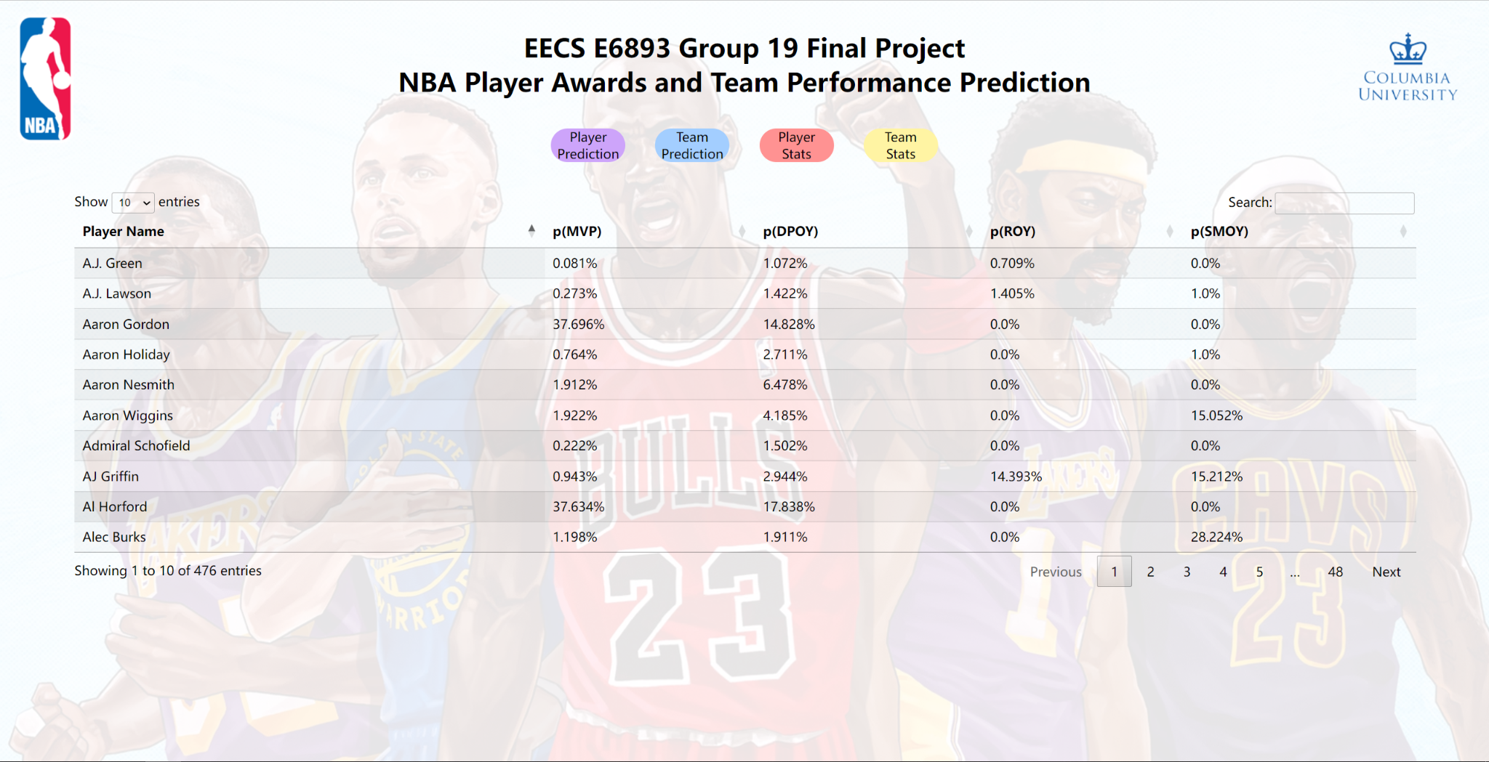
Web Interface
Visualize csv files from BigQuery using D3

Slide 10
Q&A
Thank you!

